Slide 1



E-BOOKING
A Web - Based Student Skill Exchange Mini Project
Website:
https://e-booking00.github.io/E-Booking/#booking-history
Team Members :
HOD CSE - AI & ML :
  24981A424E - B.MANASVI (TL)
  24981A425J - M. SANDHYA
  24981A426H - A. BHANUPRAKASH
  24981A4285 - K. MANOJ
  24981A428C - N. AKHIL
Dr. G. Sridevi
Guided By :
Mr. K. Sandeep Kumar
Assistant Proffesor

Slide 2

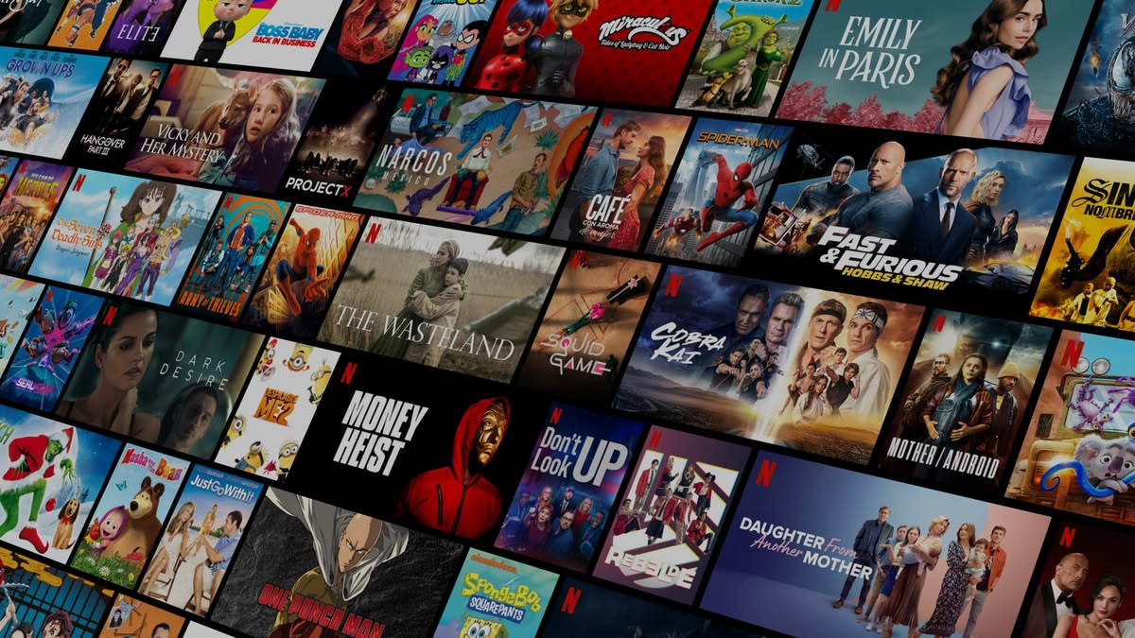
CONTENTS
Abstract
System Features
01
05
02
Introduction
Project Demo
06
Project Objectives & Scope
Core Modules
03
07
04
Techology
08
Key Code Snippets
09
Conclusion

Slide 3
ABSTRACT
E-Booking is a web-based movie ticket booking system that allows users to browse movies, select shows and seats, and confirm bookings online. Developed using HTML, CSS, and JavaScript, the system provides a simple, responsive, and user-friendly booking experience. It also includes seat availability, booking history, and cancellation features.
ABSTRACT: https://drive.google.com/file/d/1DJ8xmLhADITFvreV73cHDFqjPSw h-_iX/view?usp=drivesdk

Slide 4
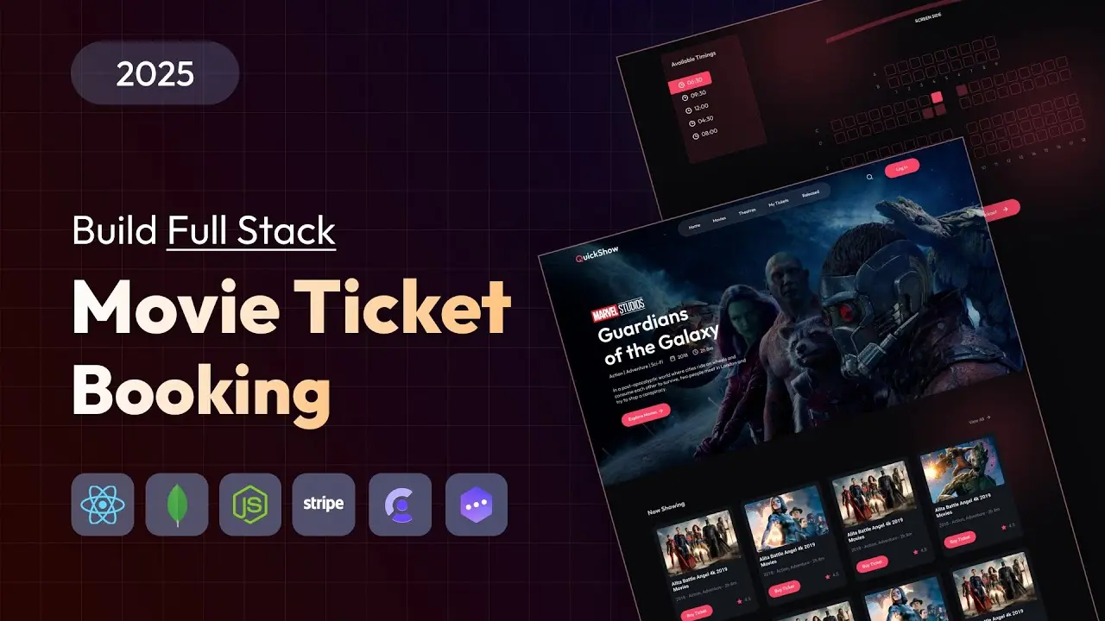

Introduction
E-Booking is a web-based movie ticket booking system designed to make the process of searching and booking movies simple, fast, and convenient. The website allows users to view available movies, select a movie and show, choose their preferred seats, and confirm their booking online. It provides an easy-to-use interface for managing movie and booking information. The system is developed using HTML, CSS, and JavaScript, focusing on a responsive and user-friendly design. E-Booking reduces the need for manual ticket booking and provides users with a convenient digital movie-booking experience.

Slide 5


Problem Statement
Traditional movie ticket booking can be time-consuming and inconvenient. Users may need to wait in queues and have difficulty checking movie and seat availability. E-Booking provides an online platform to browse movies, select shows and seats, and confirm tickets easily, reducing time and effort.

Slide 6

TECHNOLOGIES USED
HTML 5 : We used HTML5 to create the structure and content of the website.
CSS3 : We used CSS3 for styling, layout, animations, and responsive design.
JavaScript : We used JavaScript to implement interactive features and booking functionality.
Visual Studio Code : We used VSCode editor for developing the website.
GitHub Pages : We used GITHUB for hosting and deploying the website online.

Slide 7
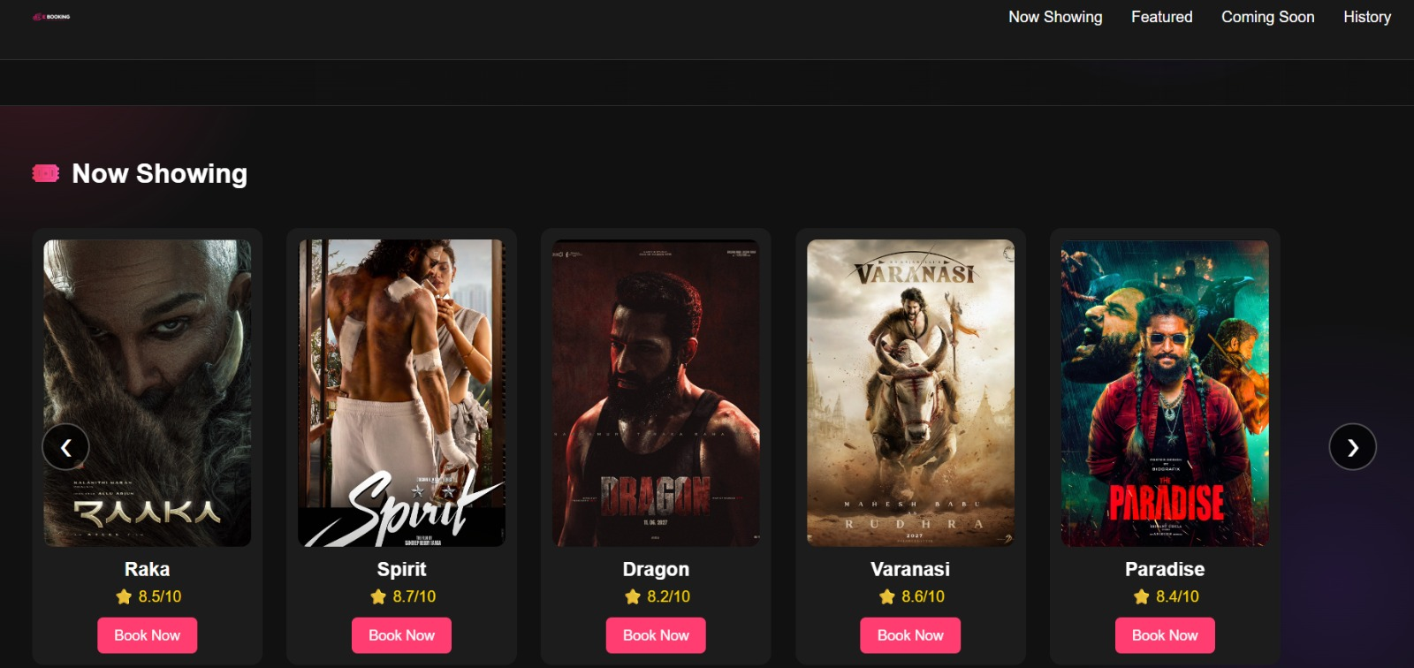
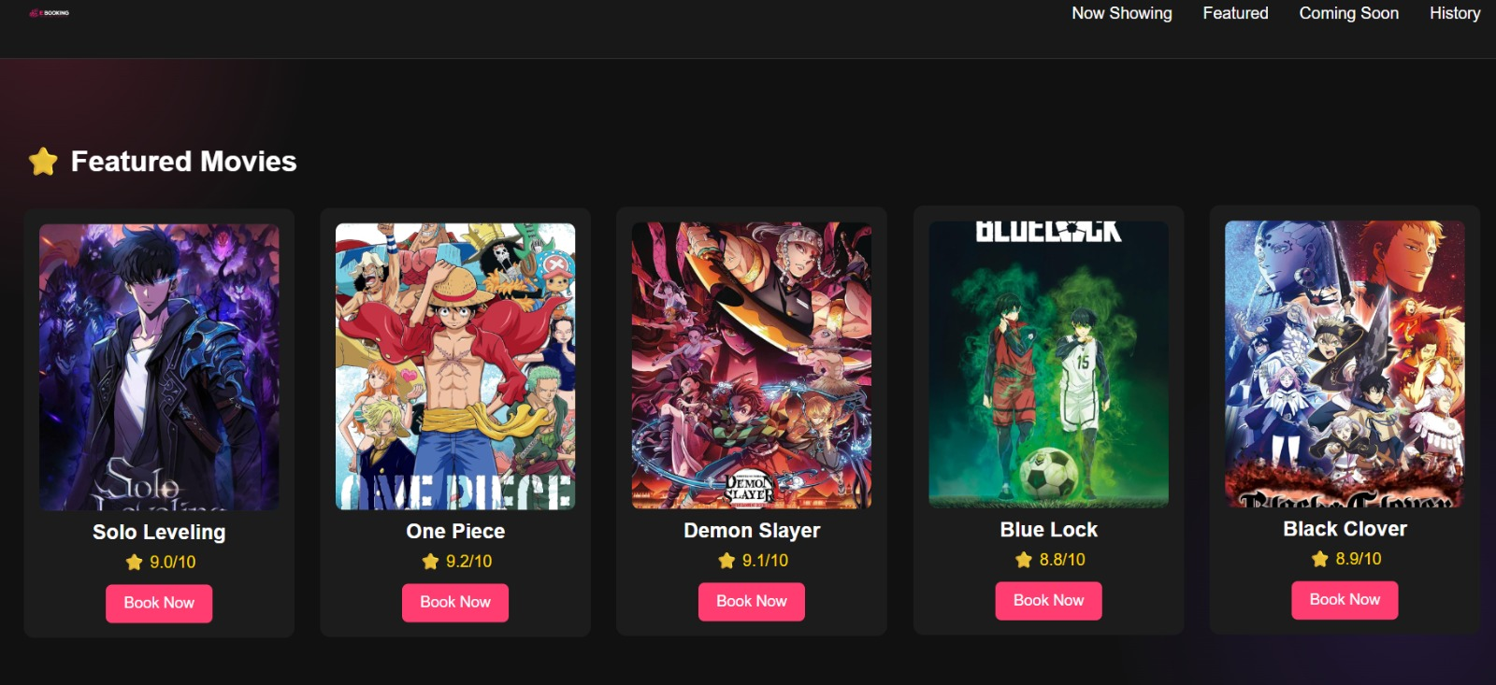
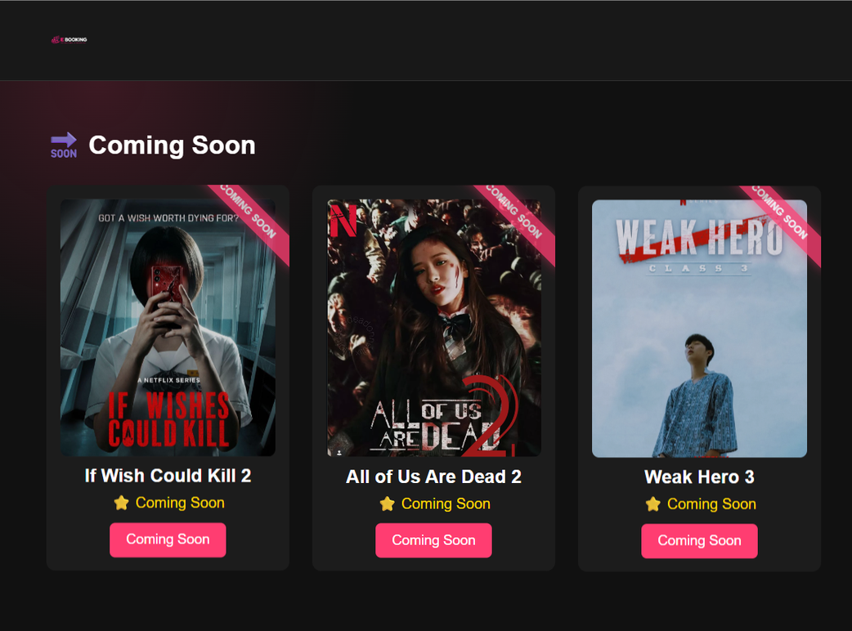
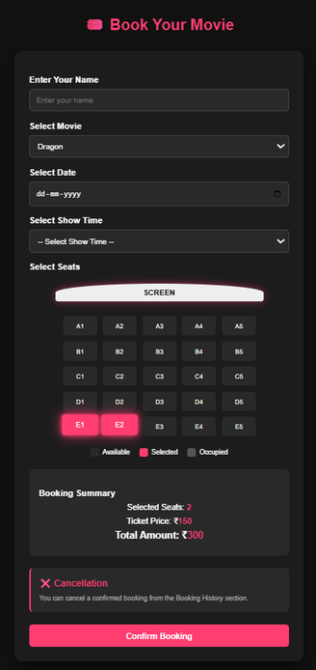
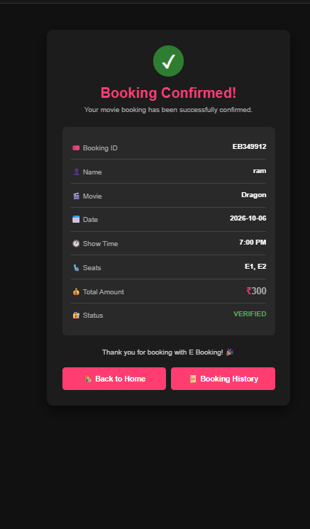
SYSTEM FEATURES

Slide 8
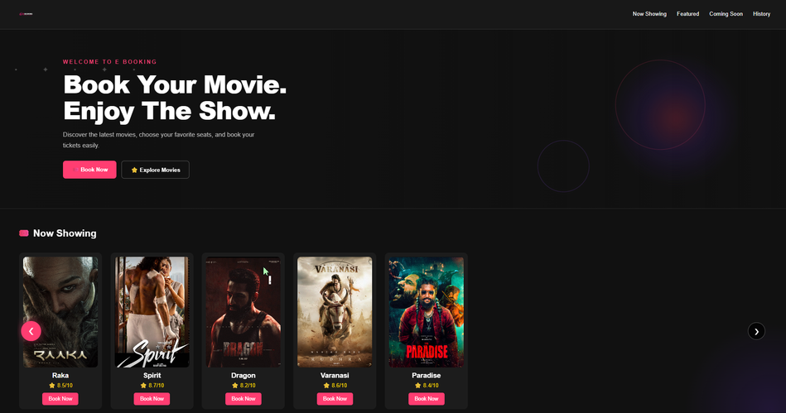
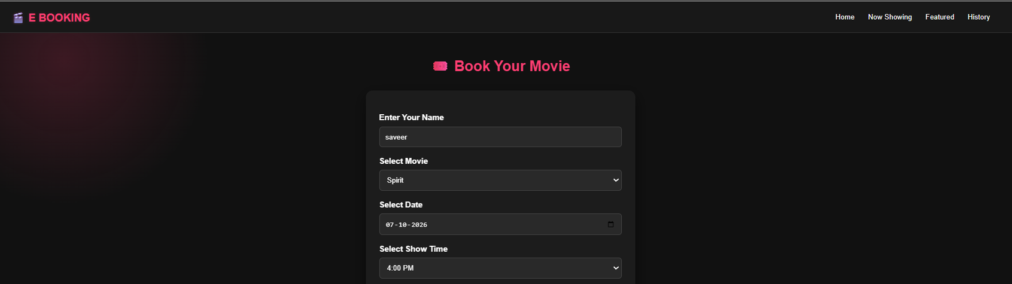

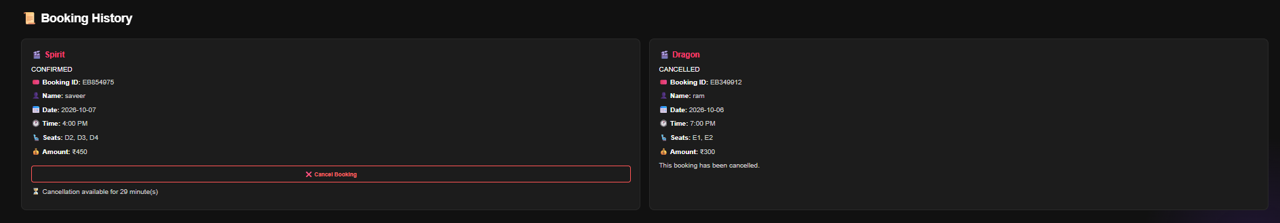
PROJECT DEMO
HOME PAGE
BOOKING PAGE
BOOKING CONFIRMATION
BOOKING HISTORY

Slide 9
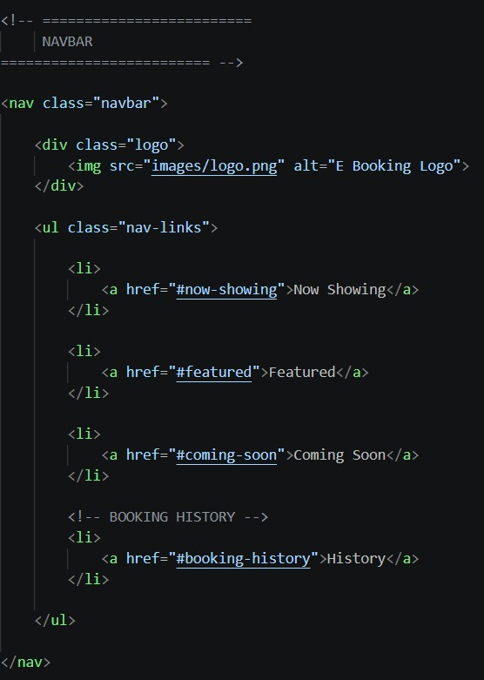
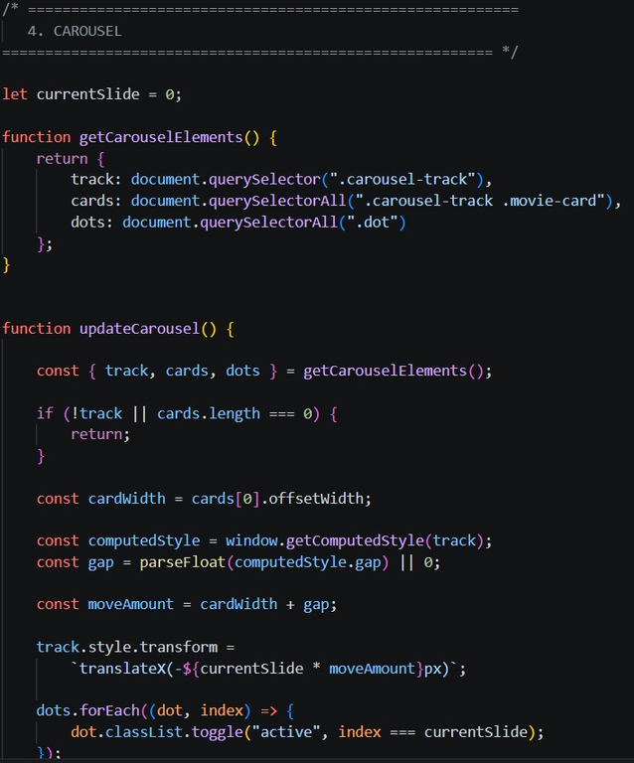
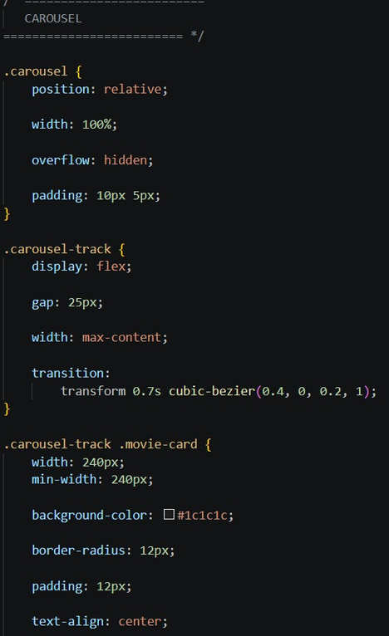
KEY CODE SNIPPETS
HTML
JAVA SCRIPT
CSS

Slide 10

Conclusion
The E-Booking movie ticket booking system provides a simple, convenient, and user-friendly platform for booking movie tickets online. Users can browse movies, view details, select show timings and seats, and confirm their bookings. The system also includes features such as seat availability, booking history, and cancellation. Developed using HTML, CSS, and JavaScript, the project demonstrates how web technologies can be used to create an interactive and responsive booking system. In the future, the system can be enhanced with a database, online payment, and real-time booking services.

Slide 11
THANK YOU
WEBSITE : https://e-booking00.github.io/E-Booking/#booking-history
ABSTRACT : https://drive.google.com/file/d/1DJ8xmLhADITFvreV73cHDFqjPSwh-_iX/view?usp=drivesdk
DOCUMENT : https://drive.google.com/file/d/1lmgF6yDv0hxulK1we2m8QG7IEN_dA2Wg/view?usp=drivesdk

